Slide 1
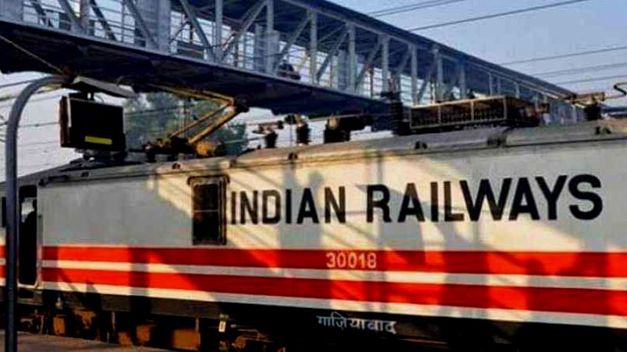
Indian Railways
Data science project on

Slide 2

.
Indian Railways (IR) is a statutory body under the ownership of Ministry of Railways, Government of India that operates India's national railway system.It manages the fourth largest national railway system in the world by size, with a total route length of 126,511 km (78,610 mi) as of 31 December 2021.
On 16th April 1853, the first passenger train ran between Bori Bunder (Bombay) and Thane, a distance of 34 km. Beginning from then Railways has become the most important mode of transportation.
We may not be able to analyse all of them at this point of time so we tried interpreting some parts from this vast pool.

Slide 3
Indian railway dataset (https://www.kaggle.com/sripaadsrinivasan/indian-railways-dataset) is available here.Initial goal is to identify task (that generates some meaningful insight) and prepare that dataset accordingly.
OUR PROJECT:
Tasks in the project:
Data collection
Data Preprocessing and Cleaning
Data Visualization
Data Statistics(Summary of statistics)
Hypothesis Testing
Prediction Testing(Using Machine Learning Model)

Slide 4
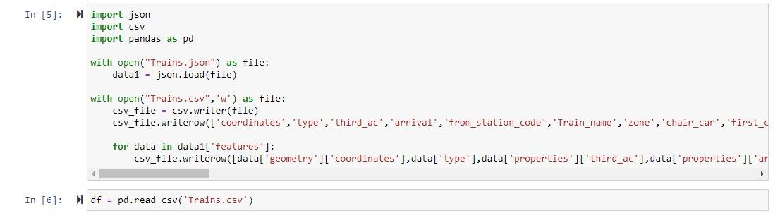
Data collection:
Data collected from: https://www.kaggle.com/sripaadsrinivasan/indian-railways-dataset
Data collected(file): Trains.json
In this we have imported json, csv and pandas library as pd.

Slide 5
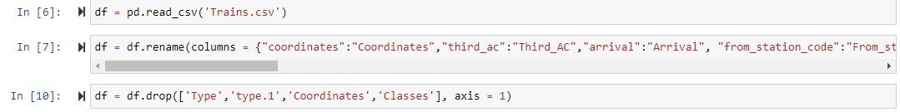
Data Preprocessing and Cleaning:
Capitalising the 1st letter of each column name as a part of cleaning
Dropping: 1.Type
2.type.1
3.Coordinates
4.Classes
We dropped the above columns as which are of no use in this project
For this we used “df.drop(“Column_name”)” command.

Slide 6
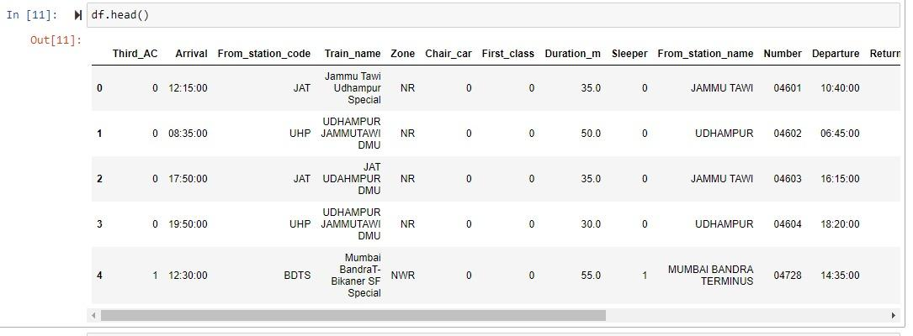
“df.head()” is used to show starting five rows of the data.
Columns we have now are:
1.Third_AC,Chair_car, First_class, sleeper -> 0 - doesn’t exist
1 - exist
2.Arrival(time-24hrs format), From_station_code, Train_name, Zone, Duration_m (in minutes), From_station_name, Number(train number), Departure(time-24hrs format).

Slide 7
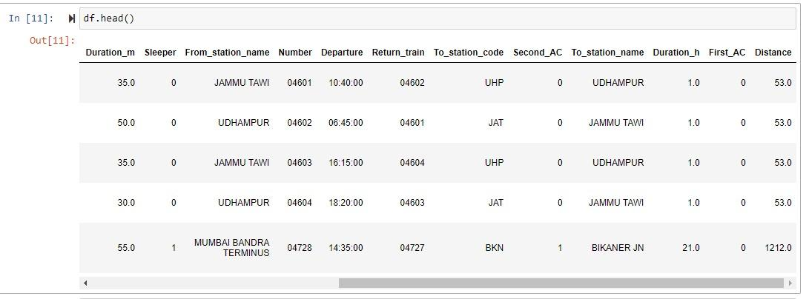
.
Columns we have now are:
1.Second_AC, First_AC, sleeper -> 0 - doesn’t exist
1 - exist
2.Duration_m (in minutes), From_station_name, Number(train number), Departure(time-24hrs format),Return_train, To_station_code, To_station_name, Duration_h(in hours),Distance(in km).

Slide 8
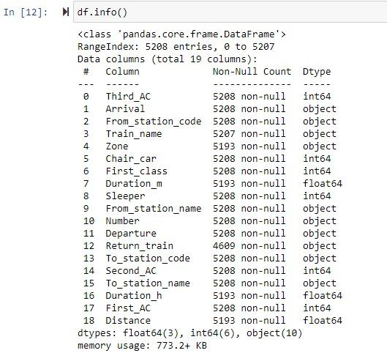
.
Info about all the columns is obtained by using the command “df.info()”
We have 19 different columns showing the count of non-null data and the data type in the respective columns.
From this we can conclude that there are some NULL values in the data which will hinder our analysis.

Slide 9
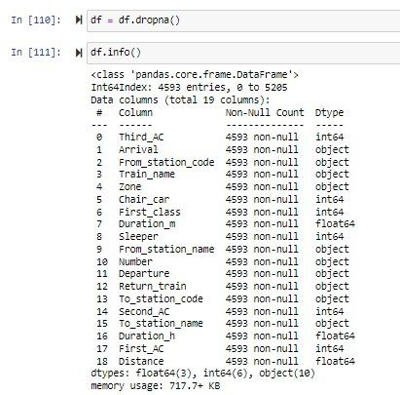
.
In order to get rid of the NULL values we used “df.dropna()” command.
We have used “df.info()” command again to make sure whether we got rid of all NULL values in the data.
With the obtained info it is evident that we got rid of all the NULL data.
.

Slide 10

Now we have some graphs visualising what all we have in our data
Data Visualization:

Slide 11
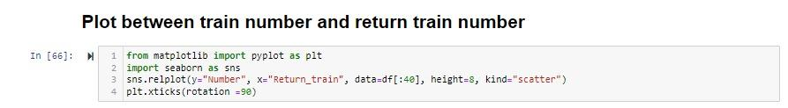
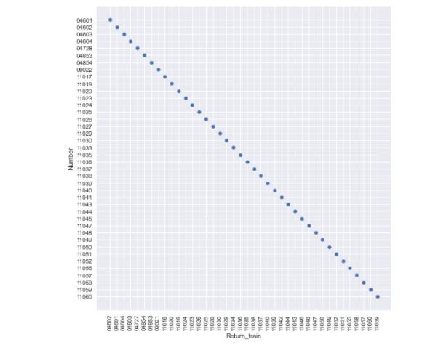
.
1
Here is a plot of train numbers of trains in their to and fro(return) journey
Train number on y-axis and return train number on x-axis

Slide 12
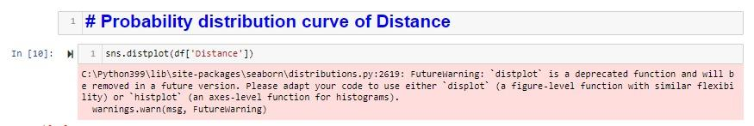
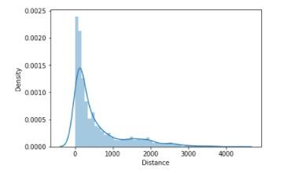
.
Density Curve of Distance
2
Here we have density curve of distance
Distance on x-axis and density of trains of y-axis
From this curve we can say that density of trains in 0 to 1000 is comparatively more than the farther distances

Slide 13

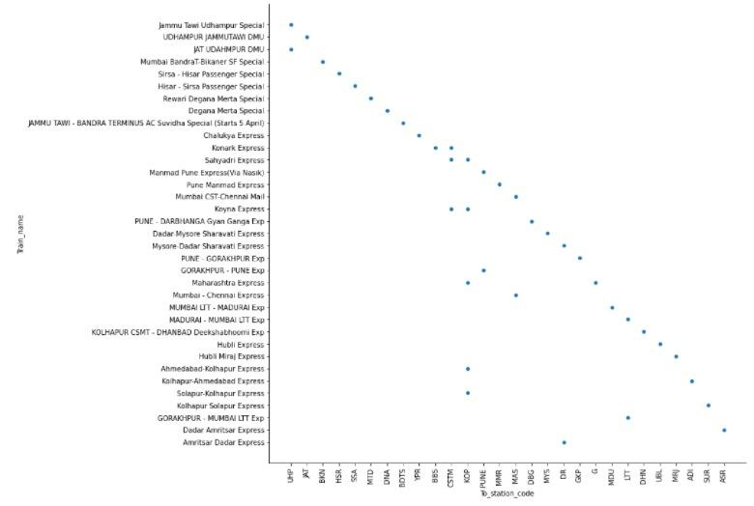
.
3
Here is a general plot between train name and it’s final destination
Destination on x-axis and train names on y-axis

Slide 14

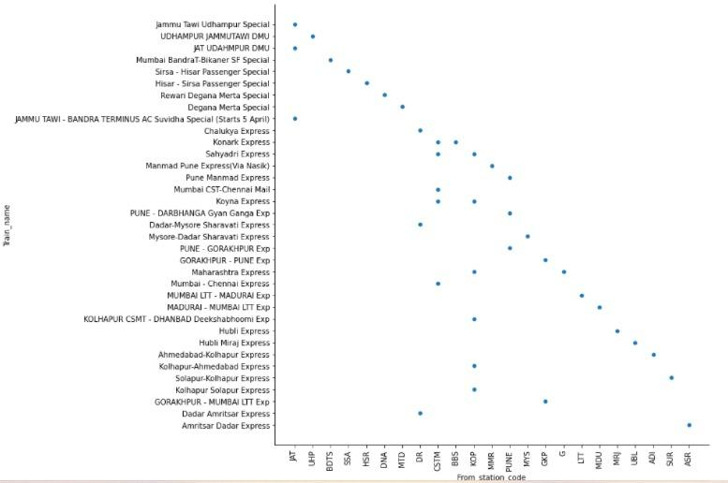
.
4
Here is the plot between train and it’s station of origin
Station of origin on x-axis and train name on y-axis
.

Slide 15
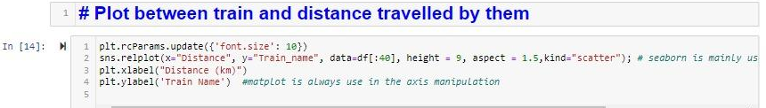
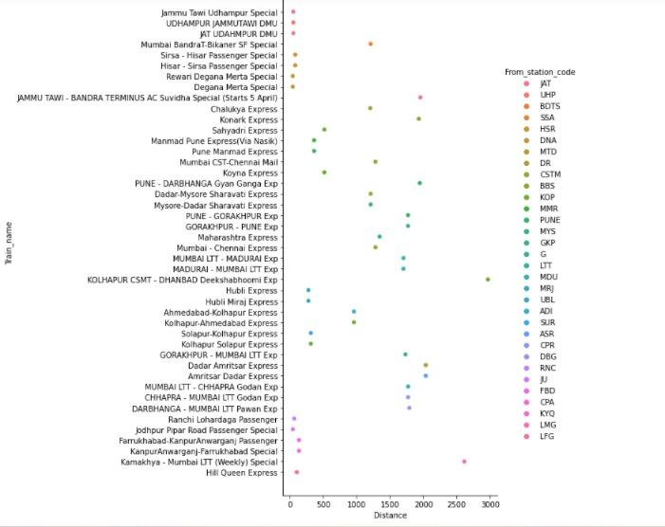
.
5
Here is a plot between train and distance travelled by it
Distances on x-axis and train names on y-axis
From this plot we can summarize that more number of trains travelled less than 1000 and very less number of trains travelled 2000
.

Slide 16

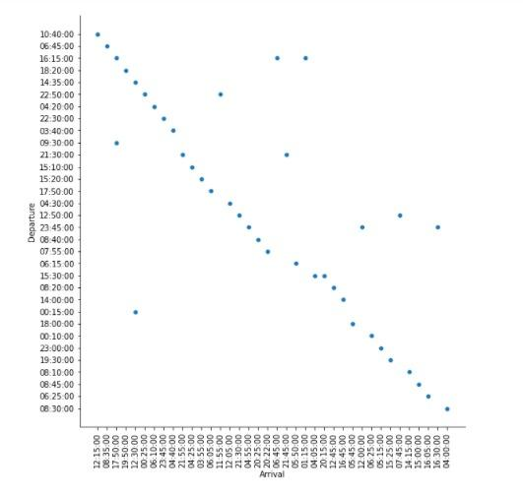
.
6
Here is a plot between arrival and departure time of each train
Arrival times on x-axis and departure times on y-axis
This plot is approximately representing a straight line showing that the train which left early will reach back early

Slide 17

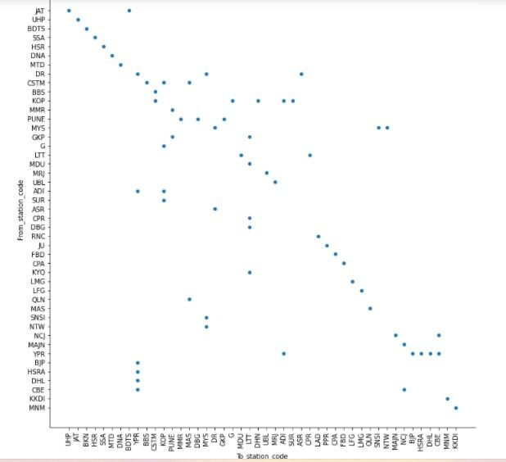
7
.
Here is a plot between number of trains that travel between any 2 station
To station codes on x-axis and from station codes on y-axis.
From this plot we can see in between which two stations there are more number of trains.

Slide 18
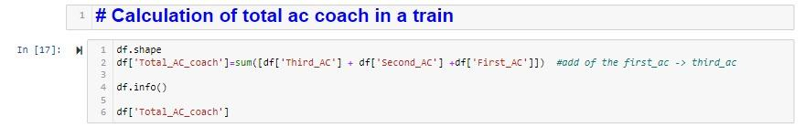
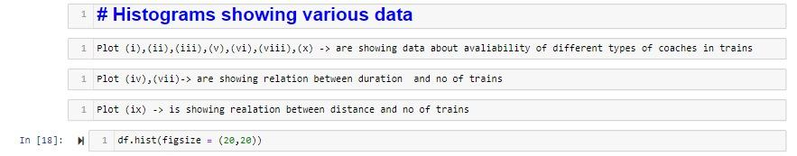
8
We have calculated total number of ac coach in each train which includes all kinds of ac coaches.
.
Histograms here shows about different availabilities, time and distance.

Slide 19
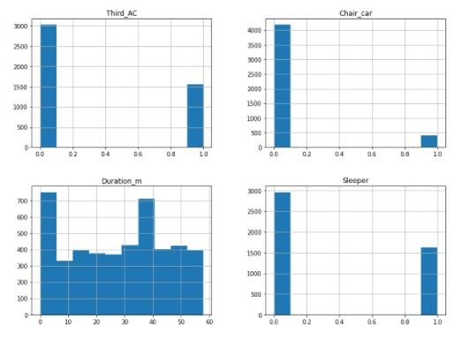
9
.
Here in the plots of Third_AC, Chair_car,Sleeper bar at ‘0’ represent non existence and bar at ‘1’ represents existence of that kind of coach
The histogram of duration in minutes shows number of trains in that particular duration.

Slide 20
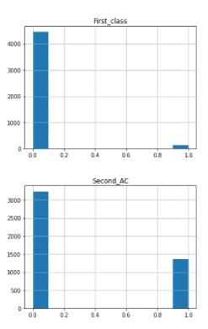
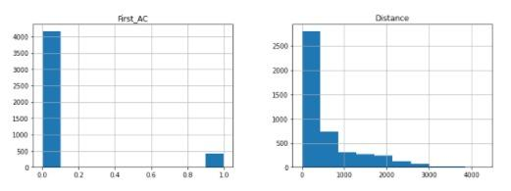
Here in the plots of First_class, First_AC,Second_AC bar at ‘0’ represent non existence and bar at ‘1’ represents existence of that kind of coach
The histogram of distance shows number of trains in that particular length of distance.
.

Slide 21
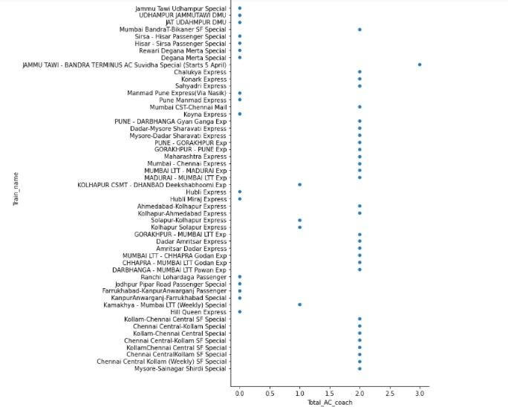
10
.
Here is a plot that shows total number of AC coaches in trains including all kinds of AC coaches
Total number of AC coaches on x-axis and train names on y-axis.
From the plot we can say that most number of trains has 2 AC coaches.

Slide 22
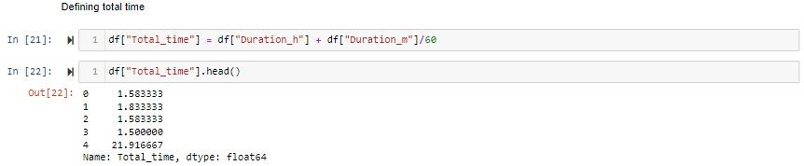
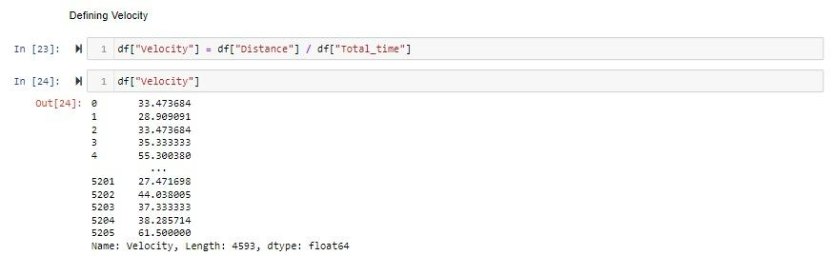
Now we have calculated some values like time and velocity which will help in next part of the analysis.
Here is the part of code finding total time in hours
.
Here is the part of code finding velocity using Distance and total time calculated just before.

Slide 23
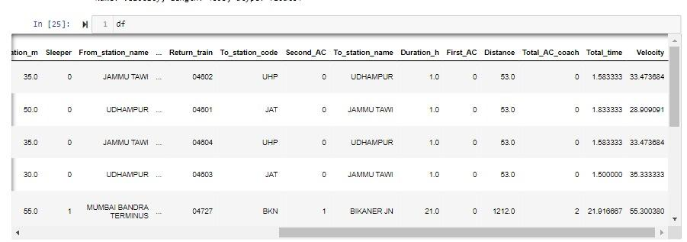
.
Now we have this total_time and velocity as extra columns which will be helpful to our upcoming hypothesis.

Slide 24
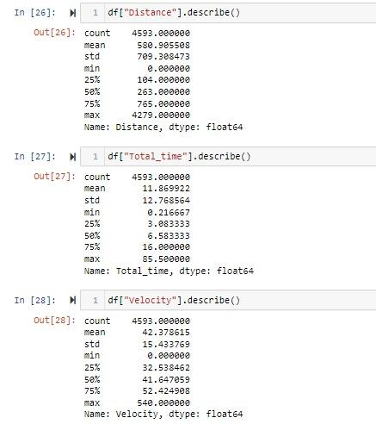
Data Statistics:
Now using the ‘describe’ function we have obtained various measures of central tendency and of dispersion.
We have obtained all those measures of Distance,Total time, Velocity.
We will use in the upcoming parts of the analysis.
Measures of central tendency and of dispersion of velocity are used to draw the probability distribution curve of it.
.

Slide 25
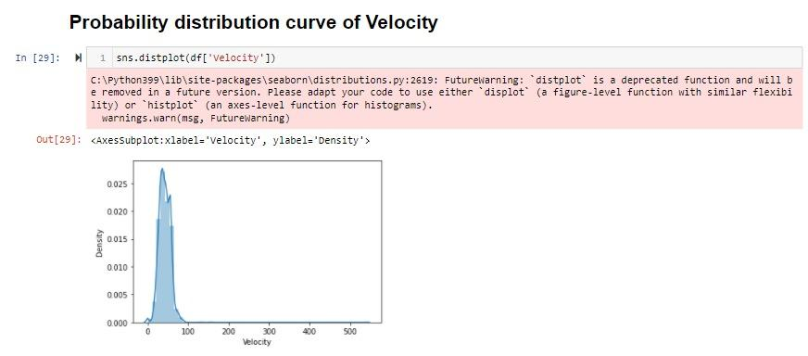
Density Curve of Velocity
.
Measures of central tendency and of dispersion of velocity are used to draw this density curve of velocity.

Slide 26
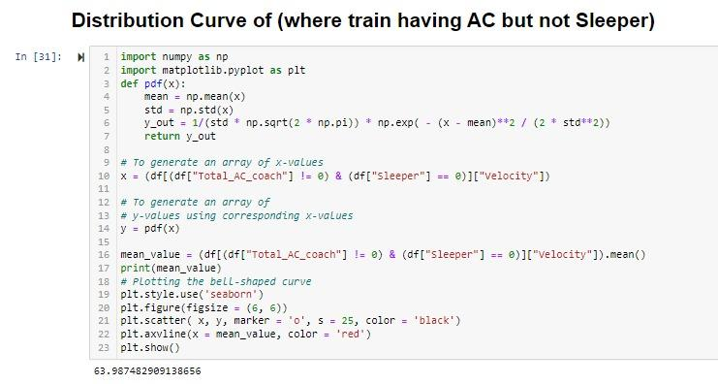

Hypothesis Testing:
Our Hypothesis: The Velocity of Train having AC but not sleeper is higher than the mean velocity
Here is the code to obtain Distribution curve for train having AC but not sleeper.
.

Slide 27
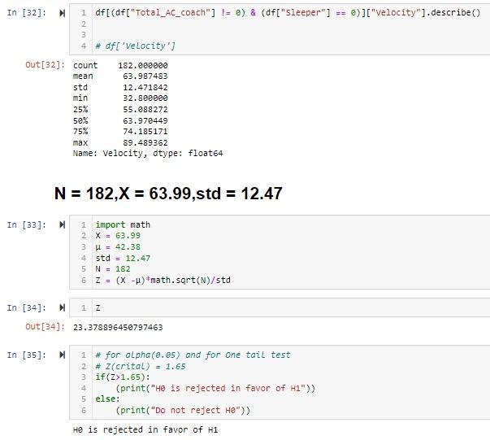
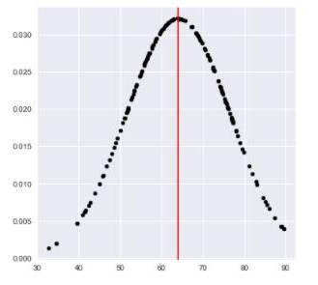
.
Probability distribution curve where train has ac but not sleeper.
We obtained that H0 is rejected in favor of H1.This means that our hypothesis statement is true.
The Velocity of Train having AC but not sleeper is higher than the mean velocity

Slide 28
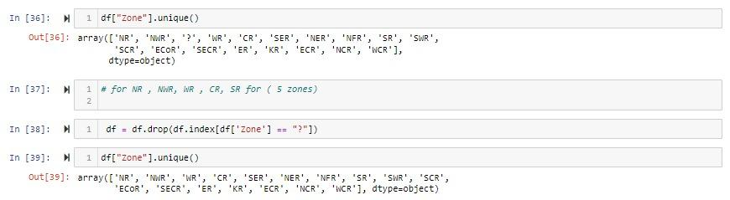
Zone wise analysis:
For better understanding we did zone wise analysis and also did drop a “?” zone as a part of cleaning.
.
Here We have different zones like “NR”, “NWR”, “WR”, “CR”, “SR”, “SWR”, “KR” and many other zones
We are considering few zones(NR, NWR, WR, CR, SR) to analyse.

Slide 29
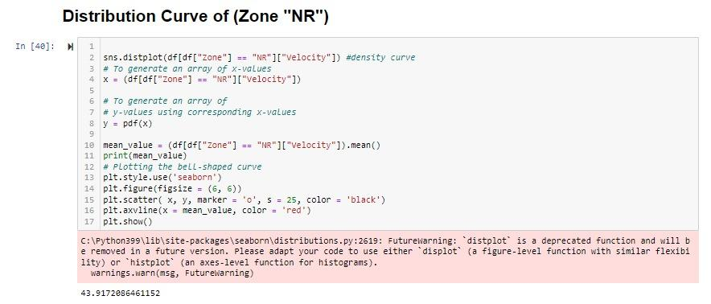
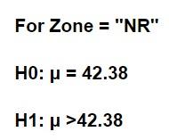
Zone NR:
.
Here is the code for obtaining distribution curve for velocity of trains in Zone “NR”

Slide 30
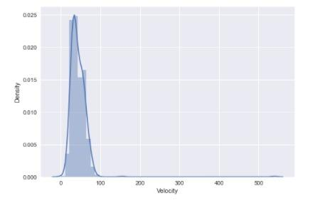
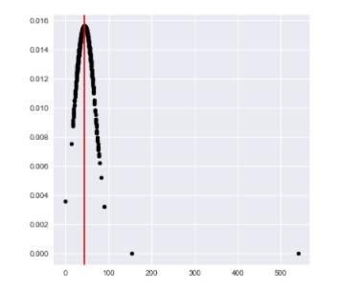
.
Here is the distribution curve of velocity of trains in Zone “NR”
From this we can say that the more number of trains has velocity less than 100 km/h.

Slide 31
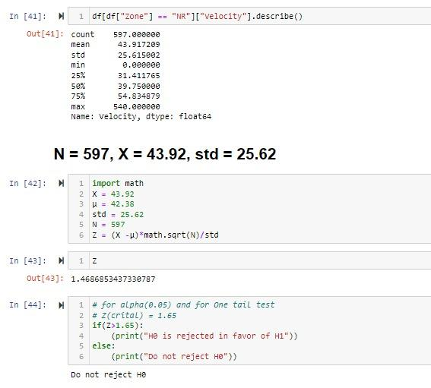
.
Measures of central tendency and of dispersion of velocity of trains in the zone “NR” are obtained by using describe function.
From those we will calculate Z and then we get less than 1.65(critical).
So now we can not decide or conclude anything regarding this Zone “NR”
We can not show any results or conclude just by this analysis for Zone “NR”

Slide 32
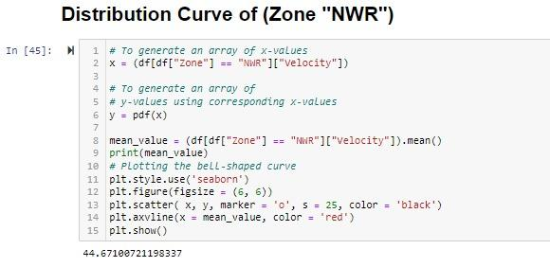
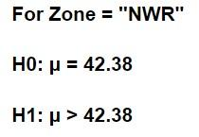
.
Zone NWR:
Here is the code for obtaining distribution curve for velocity of trains in Zone “NWR”

Slide 33
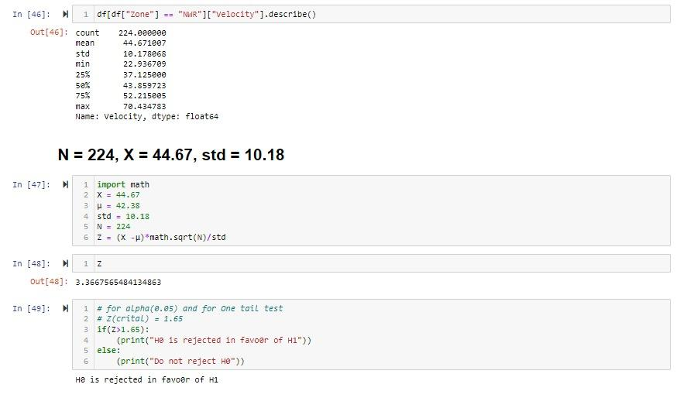
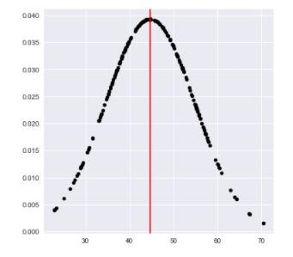
.
Here is the distribution curve of velocity of trains in Zone “NWR”.
Measures of central tendency and of dispersion of velocity of trains in the zone “NWR” are obtained by using describe function.
Z obtained is greater than 1.65 so H0 is rejected in favour of H1.
So velocity of trains in Zone “NWR” is higher than the mean velocity.

Slide 34
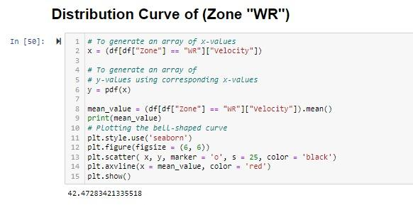
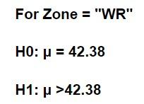
.
Zone WR:
Here is the code for obtaining distribution curve for velocity of trains in Zone “WR”

Slide 35
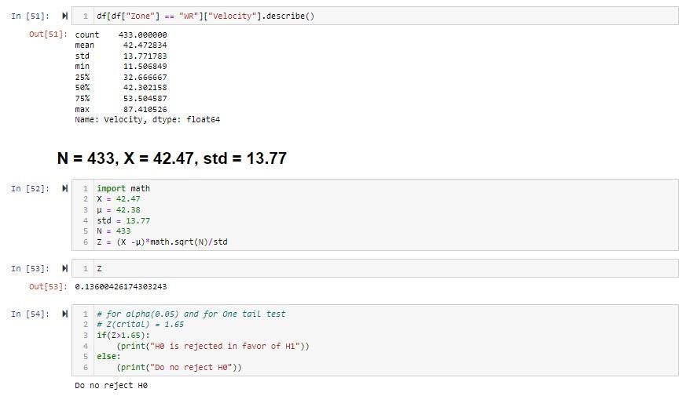
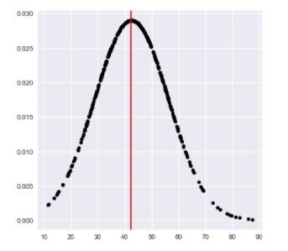
.
Here is the distribution curve of velocity of trains in Zone “WR”.
Measures of central tendency and of dispersion of velocity of trains in the zone “WR” are obtained by using describe function.
Z obtained is less than 1.65 so H0 is not rejected.
So we can not conclude anything about this zone with this kind of analysis.

Slide 36
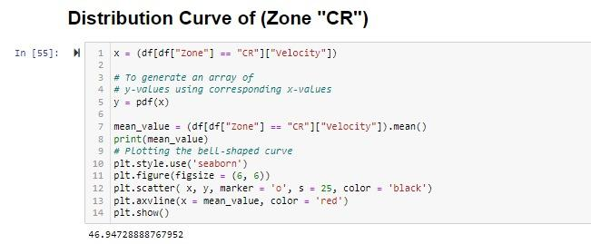
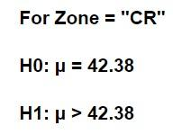
.
Zone CR:
Here is the code for obtaining distribution curve for velocity of trains in Zone “CR”

Slide 37
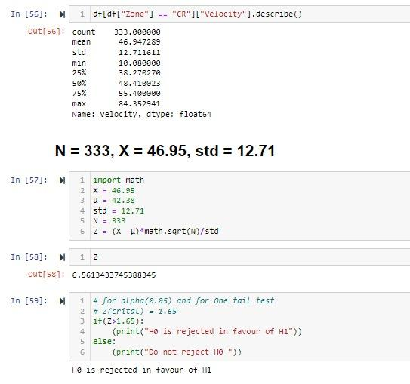
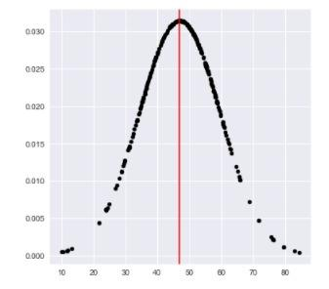
.
Measures of central tendency and of dispersion of velocity of trains in the zone “CR” are obtained by using describe function.
Z obtained is greater than 1.65 so H0 is rejected in favour of H1.
So velocity of trains in Zone “CR” is higher than the mean velocity.

Slide 38
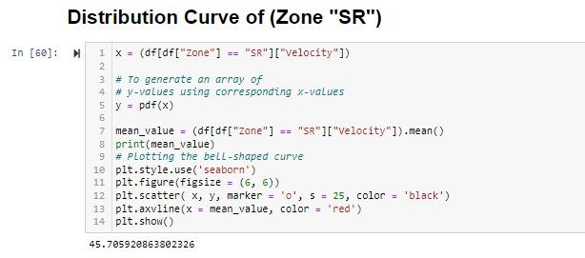

.
Zone SR:
Here is the code for obtaining distribution curve for velocity of trains in Zone “SR”

Slide 39


.
Measures of central tendency and of dispersion of velocity of trains in the zone “SR” are obtained by using describe function.
Z obtained is greater than 1.65 so H0 is rejected in favour of H1.
So velocity of trains in Zone “SR” is higher than the mean velocity.

Slide 40
We did a prediction interpreting Distance travelled by a train and the kinds of coaches (classes) in that train
We used linear regression in multiple ways to draw the final output instead of classifiers.
So far we have already done task 1 to 5, now we are here with task 6 that is prediction
Prediction Task:

Slide 41

Just like we did previously we have imported numpy, pandas, csv using import function.
By using the shape function we got the number of rows and columns in the data.

Slide 42

By using “df.head()” we got the starting 5 rows of the data with 23 columns.
Columns are just like the ones we had previously.
Those are,
1.Third_AC,Chair_car, First_class, sleeper -> 0 - doesn’t exist ,1 - exist
2. Arrival(time-24hrs format), From_station_code, Train_name, Zone, Duration_m (in minutes), From_station_name, Number(train number), Departure(time-24hrs format).

Slide 43


Just by using “df ” we got all the 5208 rows and 24 columns of the data.
Next to this we got rid of null values using drop function.
Then we have checked the number of rows and columns again after dropping.

Slide 44

By using correlation function(“df.corr()”) we have correlated distance and kinds of coaches.

Slide 45

We used 80% data for training and 20% data for testing of the model.
We defined features using variable X and distance by using Y which are our variables for linear regression Curve.

Slide 46


In statistics, linear regression is a linear approach for modelling the relationship between a scalar response and one or more explanatory variables (also known as dependent and independent variables)
By using the fit function we got the equation mentioned below with features first ac, sleeper, third ac, second ac, chair car
We are predicting distance in our model
From this above code for linear regression, we get equation coefficient.

Slide 47


By using linear regression, we obtained the line equation mentioned before and we got the intercept value 166.82
R-squared (R2) is a statistical measure that represents the proportion of the variance for a dependent variable that's explained by an independent variable or variables in a regression model.
For our model R^2 value comes out to be 0.65 for the test data.

Slide 48
Conclusion:
The Velocity of Train having AC but not sleeper is higher than the mean velocity.
The velocities of trains in zones “SR”, “CR”, “NWR” are higher than the mean velocity.
To analyse the Zones “WR”, “NR” we don’t have enough data so we can not conclude about the trains velocity in the zones.
IN PREDICTION, we can predict the distance travelled by a train if we have data regarding the classes of coaches in it with 0.65 as R-square value.

Slide 49
Lakshya agarwal (Team Leader)
Deepanshu Sharma
Divya
TEAM MEMBERS:

Slide 50
.
THANK YOU!

